Slide 1



NAB – NP&G Interop Report
2021 06 08

Slide 2
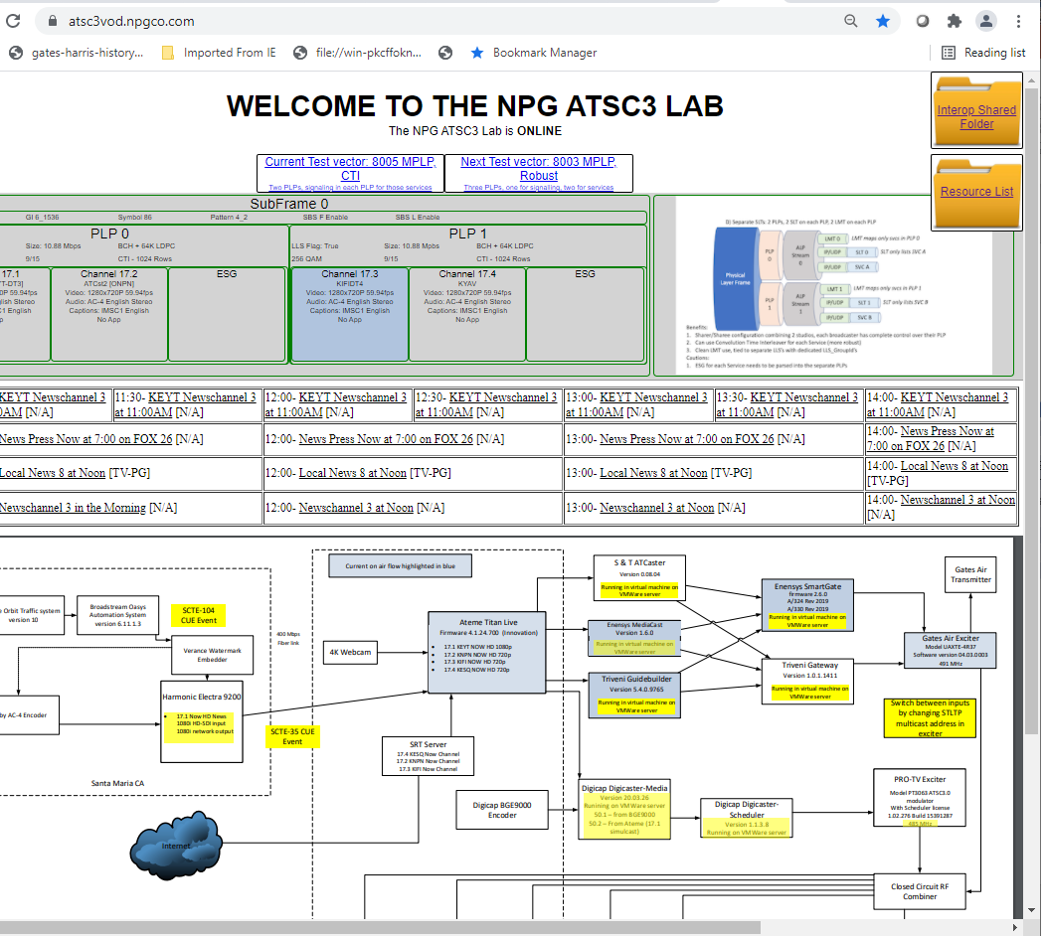
Status
13 Participants
Airwavz, Ateme, Enensys, Eurofins-Digital Testing (EDT), Fox, LG Electronics, Pearl, Samsung, Sinclair Broadcast Group (SBGTV), Sony, News Press and Gazette (NPG), NAB, Unisoft (for S&T)
Operation started March 25, 2021
Public website: https://atsc3vod.npgco.com/
Test Plan provided by ATSC: A331-V&V-Parameter-Set_r5.xls
Tests conducted and resulting pcaps submitted to CTA (3)
Vector 4002: CEA 608 to IMSC1 captions
Vector 4006: Descriptive Audio
Vector 5001: Simple ESG
Testing
Vector 8005: Multiple PLP with CTI
Tests planned
Vector 8003: MPLP with robust audio
Vector 8007: MPLP with multiple FFT
…

Slide 3
ATSC V&V Test Vector Summary
V&V Work Plan Outline
 | Phase | Step | Num Vectors | Details
 | Phase 10 |  |  | LLS
 |  | Step 1 | 14 | SLT
 |  | Step 2 | 2 | RRT
 |  | Step 3 | 9 | AEA
 |  | Step 4 | 3 | OnScreenMessageNotification
 |  | Step 5 | 2 | SMT
 |  | Step 6 | 1 | UserDefined
 |  | phase 10 total= | 31 | complete: | 6
 | Phase 11 |  |  | SLS - ROUTE
 |  | Step 1 | 6 | USBD
 |  | Step 2 | 13 | DASH MPD
 |  | Step 3 | 10 | S-TSID
 |  | Step 4 | 2 | APD
 |  | Step 5 | 7 | HELD
 |  | Step 6 | 3 | DWD
 |  | Step 7 | 3 | RSAT
 |  | phase 11 total= | 44 | complete: | 8
 | Phase 12 |  |  | SLS - MMT
 |  | Step 1 |  | MMT MPU
 |  | Step 2 |  | MMT mmt_atsc3_message
 |  | Step 3 |  | MMT video stream properties descriptor
 |  | Step 4 |  | MMT atsc staggercast descriptor
 |  | Step 5 |  | MMT audio stream properties descriptor
 |  | Step 6 |  | MMT caption asst descriptor
 |  | Step 7 |  | MMT DRM
 |  | Step 8 |  | MMT Signed message
 |  | Step 9 |  | MMT content advisory ratings
 |  | phase 12 total= | 0 | complete: | 0
 | Phase 13 |  |  | Captions
 |  | Step 1 | 6 | IMSC1
 |  | phase 13 total= | 6 | complete: | 4
 | Phase 14 |  |  | ESG
 |  | Step 1 | 8 | SGDD/SGDU
 |  | phase 14 total= | 8 | complete: | 1
 | Phase 15 |  |  | Content Replacement
 |  | Step 1 | 1 | Xlinks
 |  | phase 15 total= | 1 | complete: | 0
 | Phase 16 |  |  | Security
 |  | Step 1 | 2 | Signing
 |  | Step 2 | 2 | DRM Encryption
 |  | phase 16 total= | 4 | complete: | 1
 | Phase 17 |  |  | STL / PHY Interface
 |  | Step 1 | 8 | Host Station Manual + current live configs
 |  | phase 17 total= | 8 | complete: | 4
 |  | Total Vectors: | 102 | complete: | 24
24/102 (23.5%) available tests

Slide 4
Roadmap
Topic | Test Vector | Est start/Duration | note
Closed Caption | 4002 | 22-Mar/14 - days | completed
Descriptive Video | 4006 | 7-Apr/7 - days | completed
Simple – ESG | 5001 | 28-Apr / 7 days | completed
Multiple PLPs | 8005 8003 8007 | 4-May/15 – 20 days | 4 -5 different configs, 3-5 days ea. See CIT slide deck
Content Advisory Rating | 5003 | 1-July/7 days
Multi-Period MPD | 2112 → 2111 | Mid-Late July? | Prelude to DAI
MMT | 8006 | Mid – late July/TBD | TBD
More topics:
Broadcast application
DRM (Content Protection)
Dynamic content replacement
“Home and Away” Audio (sync0
SHVC (in M-PLP or Hybrid?)
Water Marking
Potential Live 4K event (TBD – Maybe August time frame)

